Slide 1

FOLLOWING
WCAG GUIDELINES FOR WEB
ACCESSIBILITY
HTTP 418
Alex
Amy
Ian
Kevin
Roger

Slide 2


WCAG Guidelines
Perceivable
Operable
The content should be presented in a way that allows users to perceive it regardless of their sensory abilities. Text must have sufficient contrast with the background and be large enough to be read, and visual and audio content must have a text alternative.
The UI must be designed in a way that allows users to interact with the content, regardless of their physical abilities. For example, navigation must be possible with a keyboard, and users must be able to pause, stop, or hide content that may cause seizures.
Understandable
Robust
The content must be written and organized in a way that makes it possible for users to understand it, regardless of their cognitive abilities.
Content should be created in a way that allows for it to be interpreted by a wide range of technologies, including assistive technologies used by people with disabilities. HTML must be used correctly and consistently, and CSS must not be used to convey important information

Slide 3

Perceivable
Alt text: Generic color swatch book with computer and components

Slide 4
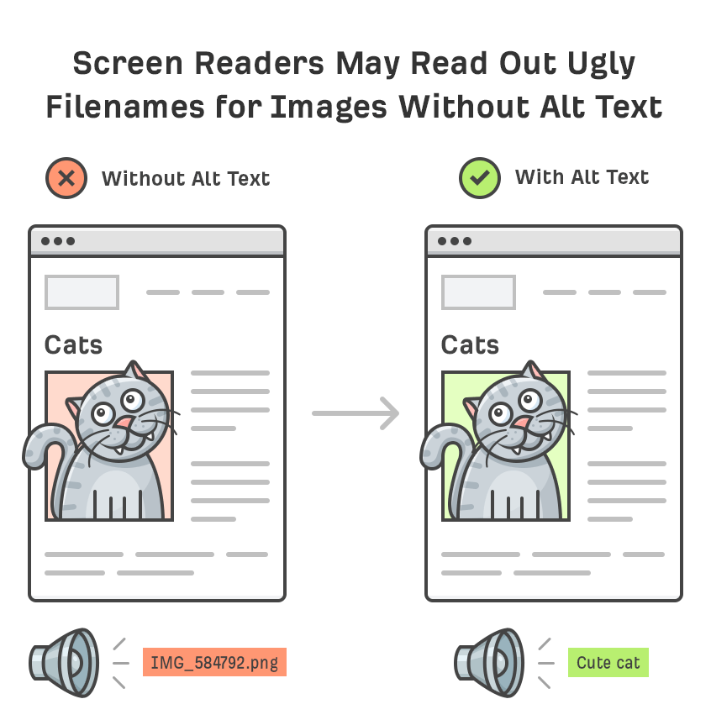
Addressing Perceivability
Guideline 1.1 Text Alternatives
Provide text alternatives for any non-text content so that it can be changed into other forms people need
Image Alt Text
Descriptive text for images for users who may have issues perceiving content
Using correct html tags to ensure alt text is readable by screen readers
Icon Tooltips
Adding descriptive text to icons prevents confusion and ensures site navigation can be understood
Tooltips should persist until the hover is removed or the user dismisses the message

Slide 5
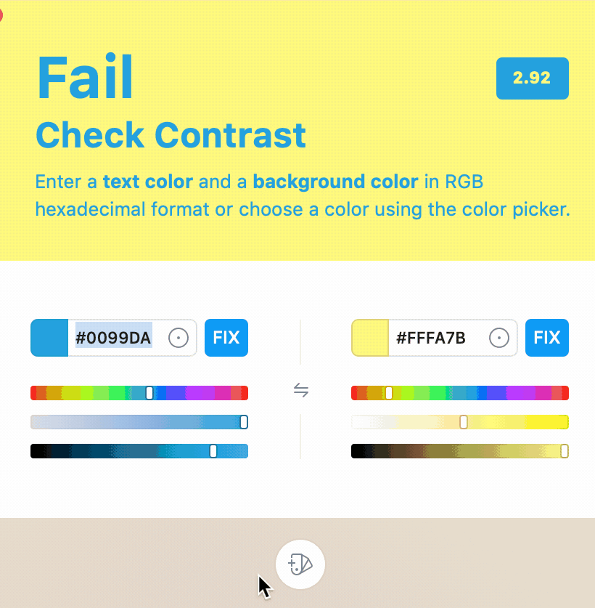
Addressing Perceivability
Guideline 1.4 Distinguishable
Make it easier for users to see and hear content including separating foreground from background.
Color Contrast
The visual presentation of text and images of text has a contrast ratio of at least 4.5:1
We will be using a contrast checker such as Sip Contrast checker to verify our color scheme is WCAG compliant
Text Size
Except for captions and images of text, text should be able to be resized without assistive technology up to 200 percent without loss of content or functionality.

Slide 6
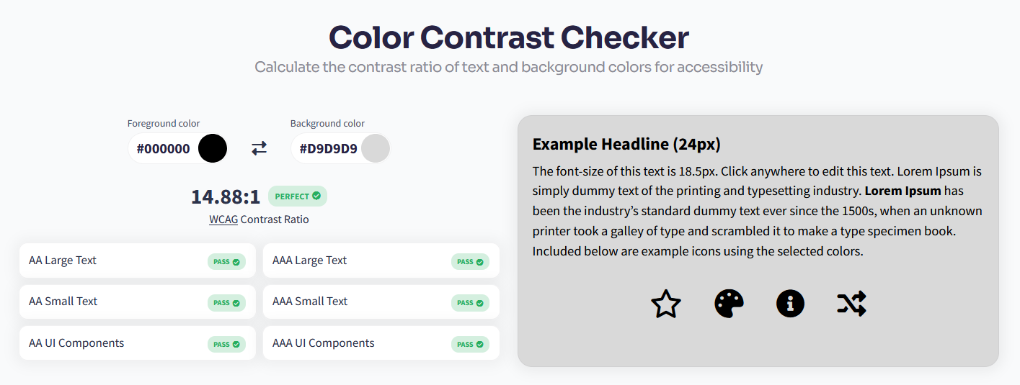



Accessibility in action
Dark Mode Alternative
Contrast Checker

Slide 7

Operable

Slide 8

Addressing Operability
Guideline 2.1 Keyboard Accessible
Functionality should be accessible from the keyboard
Logical tab order
Keyboard friendly navigation menus, links, and buttons
Guideline 2.2 Enough Time
Provide users enough time to read content
We will be avoiding time limits for content.
The user will have control over when activities are triggered

Slide 9

Addressing Operability
Guideline 2.4 Navigable
Provide ways to help users navigate, find content, and determine where they are
Page Titles
Web pages have titles that describe topic or purpose
Link Purpose
The purpose of each link can be determined from the link text alone or from the link text together with its programmatically determined link context
Headings and Labels
Headings and labels describe topic or purpose

Slide 10

Addressing Operability in Back-End Code
React
Semantic HTML
Using HTML elements to structure content based on each element’s meaning instead of its appearance
Describes the meaning and structure of content, increasing accessibility for assistive technologies
Makes markup easy for automated tools to decipher
Components
Custom components can be designed with accessibility in mind.
Dynamic Content
Dynamically render and update content in real-time without having to reload pages

Slide 11
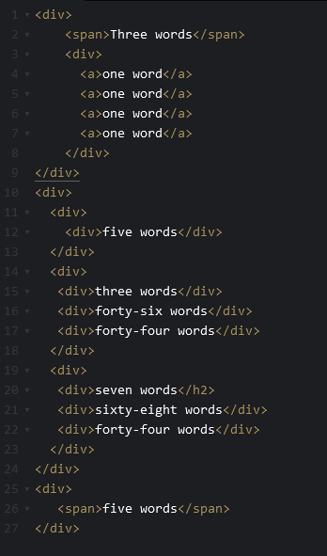
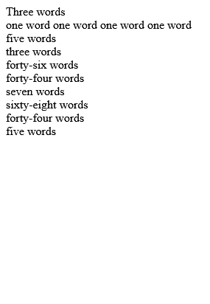
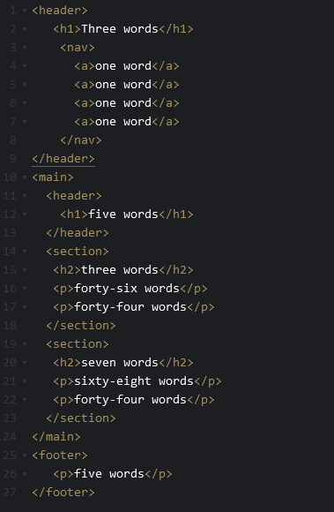
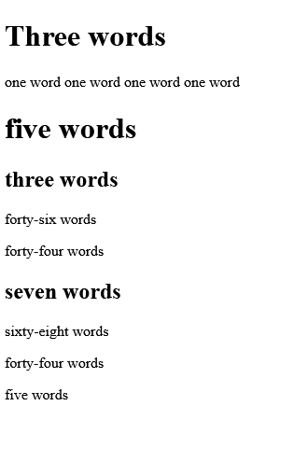
Semantic HTML
With Semantic HTML
Without Semantic HTML
Semantic elements provide meaning and structure
Architecture is clear
Clear hierarchy of content
Elements have no meaning
Difficult to tell what the content represents

Slide 12
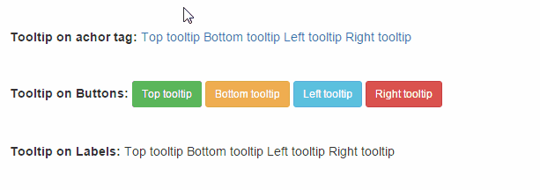
Using Tooltips
Tooltips should include text alternatives that can be read by screen readers, so that users with visual impairments can understand the content of the tooltip.
Ensure keyboard accessibility
Use proper contrast
Avoid using color alone to convey information.
The label for the trigger element (e.g. button, link) that opens the tooltip should be clear and descriptive, so that users with disabilities can understand what the tooltip contains.
Use semantic HTML to ensure proper labeling and accessibility to assistive technologies.
Regularly test the tooltips with assistive technologies, such as screen readers, to ensure that they are accessible and usable for users with disabilities.

Slide 13
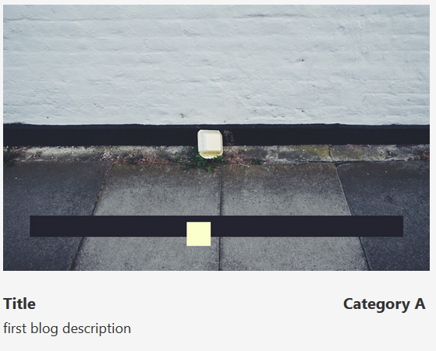
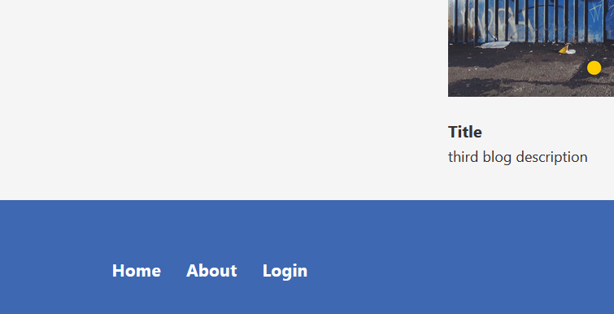
Accessibility in action
Link Purpose
Headings and Labels

Slide 14

Understandable

Slide 15

Addressing Understandability
Guideline 3.1 Readable
Text content is readable and understandable
Language of the Page
Default human language of the page is programmatically determined
Abbreviations or acronyms will have a mechanism for identifying the expanded form or meaning

Slide 16

Addressing Understandability
Guideline 3.2 Predictable
Make Web pages appear and operate in predictable ways
Consistent Navigation
Navigational mechanisms that are repeated on multiple Web pages within a set of Web pages occur in the same relative order each time they are repeated, unless a change is initiated by the user
We will be implementing a header and footer that will be present on every page in the site, allowing for consistent navigation mechanisms

Slide 17

A well-structured layout and navigation system makes it easier for users to find the information they are looking for and move around the site.
We hope to create a layout and navigation structure that can be easily navigated using only the keyboard.
A well-structured layout and navigation system can help screen reader users to quickly and easily understand the content and structure of our blog.

Slide 18

Robustness & Backend Best Practices

Slide 19

Addressing Robustness
Guideline 4.1 Compatible
Maximize compatibility with current and future user agents, including assistive technologies
Parsing
Ensuring that web content is understandable by different types of software:
Complete start and end tags
Appropriate nesting by specification
No duplicate attributes
IDs are unique
Code Review

Slide 20

Addressing Robustness
Guideline 4.1 Compatible
Maximize compatibility with current and future user agents, including assistive technologies
Status Messages
Status messages will be programmatically determined through role or properties such that they can be presented to the user by assistive technologies without receiving focus
Statement contains:
Level of accessibility achieved
The version of guidelines used
A brief summary of the website’s accessibility status

Slide 21
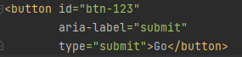
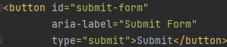

Addressing Robustness in Back-End Code
Code Clarity
Maintaining easily identifiable functions and variables to improve readability
Streamlines the error handling and debugging process
Allows developers to quickly identify and assess which functions are cause errors.
Consistent Naming Conventions
Help developers understand the purpose of different elements in the code

Slide 22
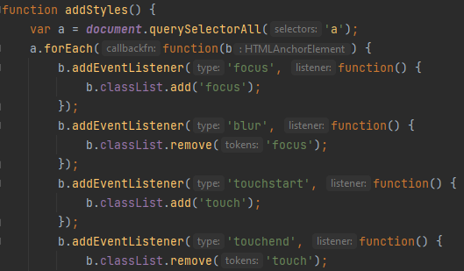
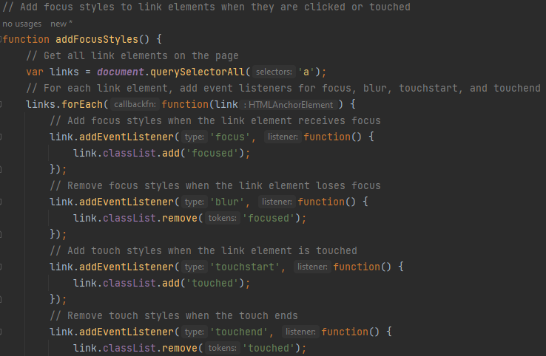
Addressing Robustness in Back-End Code
Documentation
Well-documented code provides clear explanations of purpose and functionality

Slide 23
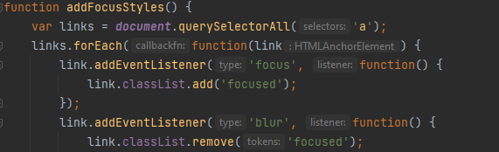
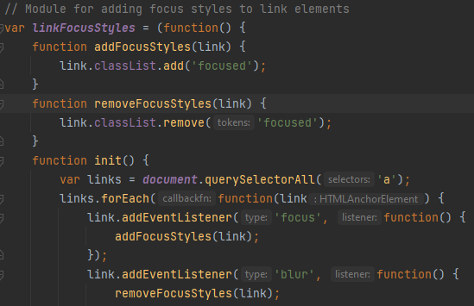
Addressing Robustness in Back-End Code
Modularization of Code
Modular code is broken up into small, reusable components
Easier to maintain
Easier to scale

Slide 24
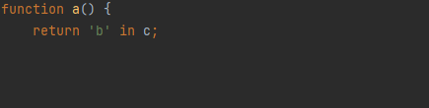
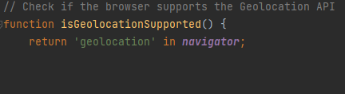
Addressing Robustness in Back-End Code
Readability
Readable code is:
Easier to understand
Helps developers understand structure and functionality

Slide 25


